Slide 1
Organizing
Assembly the people
Allocating the resources
Distributing the plan
Implementation
Organizations are systems created to achieve common goals through people-to-people and people-to-work relationships. They are essentially social entities that are goal-directed, deliberately structured for coordinated activity systems, and is linked to the external environment. Organizations are made up of people and their relationships with one another. Managers deliberately structure and coordinate organizational resources to achieve the organization’s purpose.
Each organization has its own external and internal environments that define the nature of the relationships according to its specific needs. Organizing is the function that managers undertake to design, structure, and arrange the components of an organization’s internal environment to facilitate attainment of organizational goals.

Slide 2
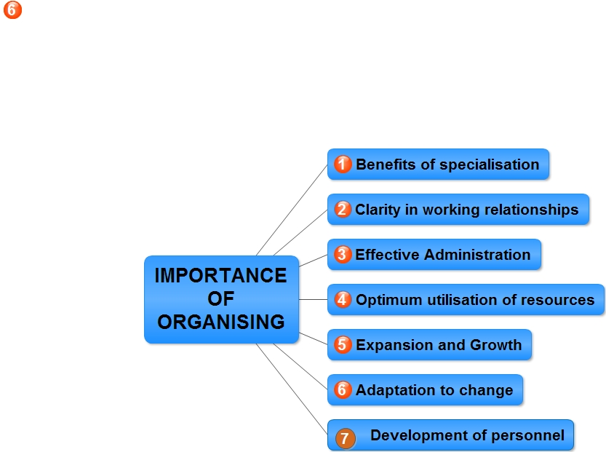
Organizing is one of the important functions of management. It is the process of defining and grouping the activities and establishing the formal relationship among them. The following are the major importance of organizing:

Slide 3
Process of Organizing
Identification and division of Work
Establishing Reporting Relationships
Departmentalisation
Assignment of Duties
Grouping of similar job in one department
And worker are doing same jobs in one department.
Grouping on the basis of nature of product and Function
Clearly define the Authority and responsibility
Every individual knows from whom take the order and submit the report.
Clearly established the superior and subordinate relationship
Work is divided into manageable activities according to the capabilities of workers
No duplication of work
Less Burdon to every workers
Setting the in charge in every department.
Right person in right place or proper match in duties and qualification.

Slide 4
Principle of Specialization
Principle of Functional Definition
Principles of Span of Control/Supervision
Principles of Organizing
Coordination
Unity of Direction
Authority and Responsibility
Principle of Unity of Command
Principle of Scalar Chain

Slide 5
The organizing process can be done efficiently if the managers have certain guidelines so that they can take decisions and can act. To organize in an effective manner, the following principles of organization can be used by a manager.
Principle of Specialization
According to the principle, the whole work of a concern should be divided amongst the subordinates on the basis of qualifications, abilities and skills. It is through division of work specialization can be achieved which results in effective organization.
Principle of Functional Definition
According to this principle, all the functions in a concern should be completely and clearly defined to the managers and subordinates. This can be done by clearly defining the duties, responsibilities, authority and relationships of people towards each other.
Clarifications in authority-responsibility relationships helps in achieving co-ordination and thereby organization can take place effectively.
For example, the primary functions of production, marketing and finance and the authority responsibility relationships in these departments should be clearly defined to every person attached to that department. Clarification in the authority-responsibility relationship helps in efficient organization.

Slide 6
Principles of Span of Control/Supervision
According to this principle, span of control is a span of supervision which depicts the number of employees that can be handled and controlled effectively by a single manager.
According to this principle, a manager should be able to handle what number of employees under him should be decided. This decision can be taken by choosing either from a wide or narrow span. There are two types of span of control
Principle of Scalar Chain
Scalar chain is a chain of command or authority which flows from top to bottom. With a chain of authority available, wastages of resources are minimized, communication is affected, overlapping of work is avoided and easy organization takes place.
A scalar chain of command facilitates work flow in an organization which helps in achievement of effective results. As the authority flows from top to bottom, it clarifies the authority positions to managers at all level and that facilitates effective organization.

Slide 7
Principle of Unity of Command
It implies one subordinate-one superior relationship. Every subordinate is answerable and accountable to one boss at one time. This helps in avoiding communication gaps and feedback and response is prompt.
Unity of command also helps in effective combination of resources, that is, physical, financial resources which helps in easy co-ordination and, therefore, effective organization
Authority and Responsibility:
Authority is the right to give orders and make decisions, while responsibility is the obligation to carry out tasks. The principle of organizing ensures a proper balance between authority and responsibility to avoid issues like overloading or underutilization of employees
Coordination:
Coordination is essential to ensure that all activities in an organization work together towards common goals. This involves harmonizing the efforts of different individuals and departments to avoid conflicts and achieve synergy

Slide 8
Organizational Structure/ Design/ Architecture= 5S
Strategy: the core approach the organization will use to accomplish its goals.
Structure: How people are situated in units and how their work is coordinated.
Systems: The process used to add value.
Skills: The capabilities of the various groups of people in the organization.
Sophistication: The values, norms, Culture and assumptions that shape behaviour.

Slide 9
Organizational Structure/ Design/ Architecture
An organizational structure is a system that outlines how certain activities are directed in order to achieve the goals of an organization. These activities can include rules, roles, and responsibilities.
The organizational structure also determines how information flows between levels within the company. For example, in a centralized structure, decisions flow from the top down, while in a decentralized structure, decision-making power is distributed among various levels of the organization. Having an organizational structure in place allows companies to remain efficient and focused.
Senior leaders should consider a variety of factors before deciding which type of organization is best for their business, including the business goals, industry, and culture of the company.

Slide 10
Needs of Organizational Structure
Businesses of all shapes and sizes use organizational structures heavily. They define a specific hierarchy within an organization.
To set roles and responsibility of each and every employee
To define the relationship between boss and subordinate
To set the communication and reporting channel
To define the who will assign the task to whom
To distribute the work out of all task.

Slide 11
Types of Organizational Structure/ Design/ Architecture
Tall vs. Flat organization Structure
Divisional Organizational Structure
Product-Based Divisional Structure
Market-Based Divisional Structure
Geographical Divisional Structure
Process-Based Structure
Functional Organizational Structure
Matrix Structure
Circular Structure
Network Structure

Slide 12
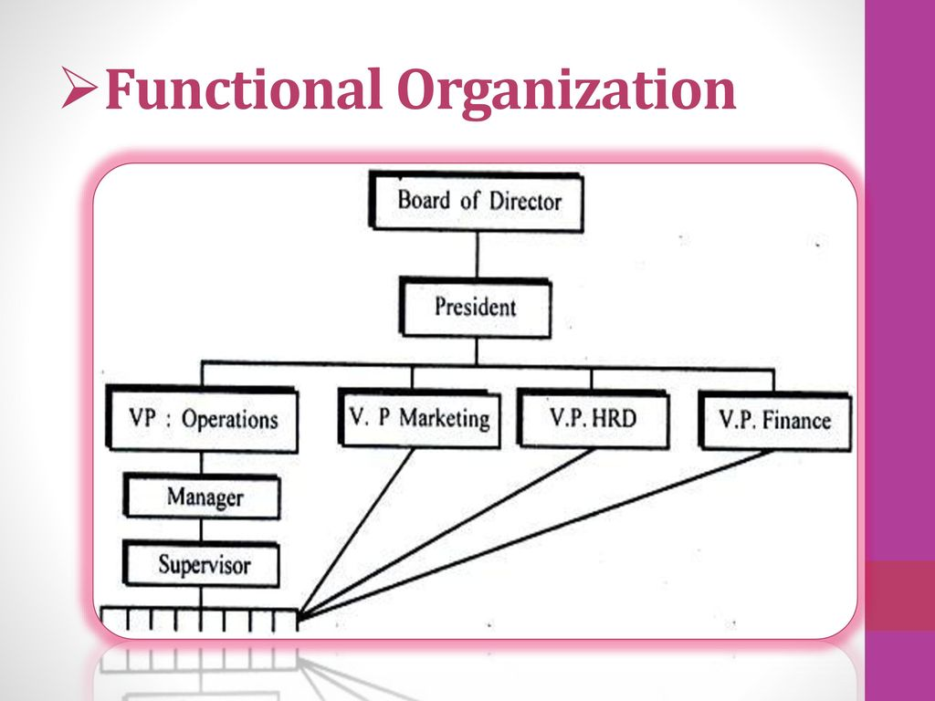
3. The functional structure
It is a centralized structure that greatly overlaps with the hierarchical structure. However, the role of a staff director instead falls to each department head – in other words, each department has its own staff director, who reports to the CEO.

Slide 13
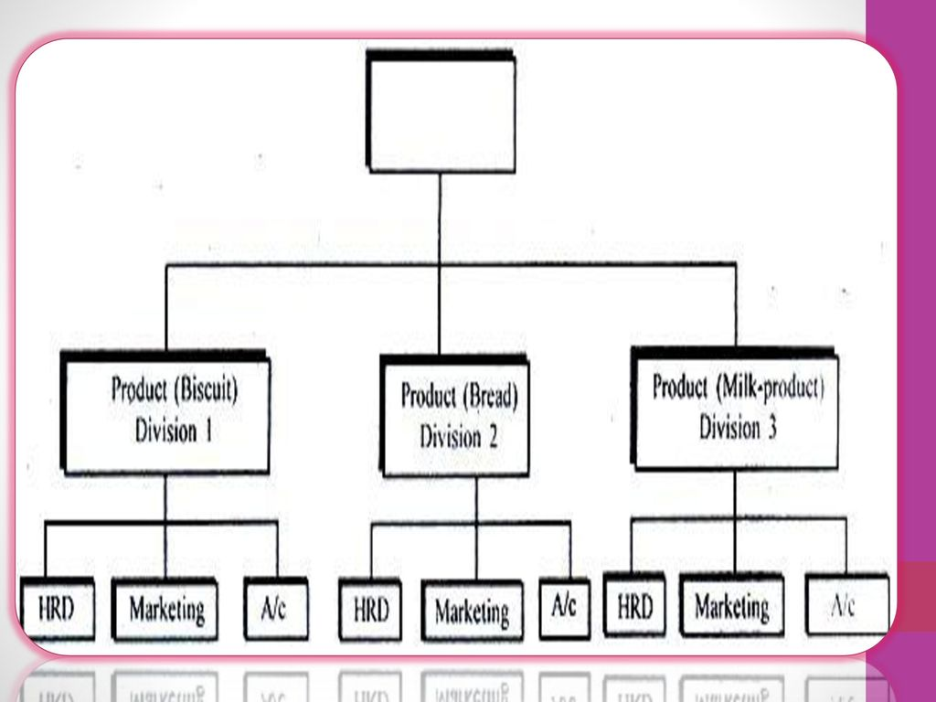
Divisional Structure
A divisional organizational structure is comprised of multiple, smaller functional structures (i.e. each division within a divisional structure can have its own marketing team, its own sales team, and so on). In this case — a product-based divisional structure — each division within the organization is dedicated to a particular product line

Slide 14
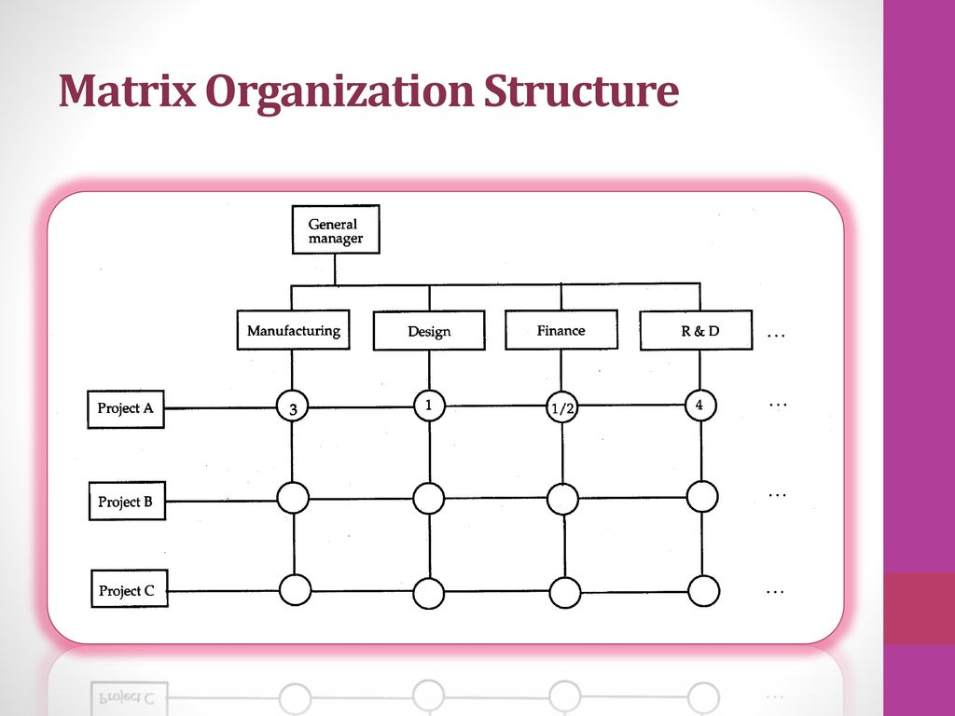
4. Matrix Structure:
The Matrix organizational structure is a hybrid of divisional and functional structure. It is typically used in large multinational companies.

Slide 15
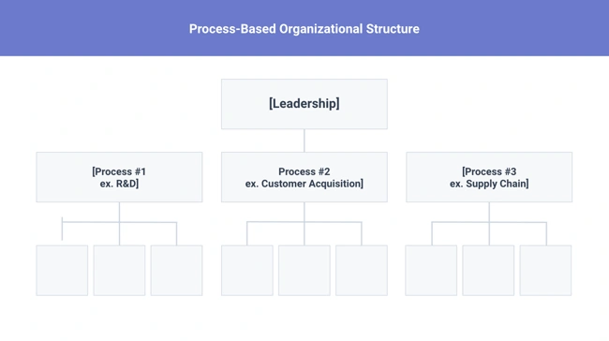
5. Process-Based Structure
Process-based organizational structures are designed around the end-to-end flow of different processes, such as "Research & Development," "Customer Acquisition," and "Order Fulfilment." Unlike a strictly functional structure, a process-based structure considers not only the activities employees perform, but also how those different activities interact with one another.
In order to fully understand the diagram below, you need to look at it from left to right: The customer acquisition process can't start until you have a fully developed product to sell. By the same token, the order fulfilment process can't start until customers have been acquired and there are product order to fill.

Slide 16
Disadvantages
It can be difficult to scale under a product-based divisional structure.
The organization could end up with duplicate resources as different divisions strive to develop new offerings.
Advantages
Companies and their employees can experience the benefits of the product-based divisional structure.
If one division performs poorly, this does not automatically translate across the organization.
Because of their separation, divisions may flourish (or fail) concurrently. This system allows companies to mitigate risk

Slide 17
Network Structure
Network structure is often created when one company works with another to share resources — or if your company has multiple locations with different functions and leadership. You might also use this structure to explain your company workflows if much of your staffing or services is outsourced to freelancers or multiple other businesses.
The structure looks nearly the same as the Divisional Structure, shown above. However, instead of offices, it might list outsourced services or satellite locations outside of the office.
If your company doesn't do everything under one roof, this is a great way to show employees or stakeholders how outsourcing of off-site processes work. For example, if an employee needs help from a web developer for a blogging project and the company's web developers are outsourced, the could look at this type of chart and know which office or which person to contact outside of their own work location.

Slide 18
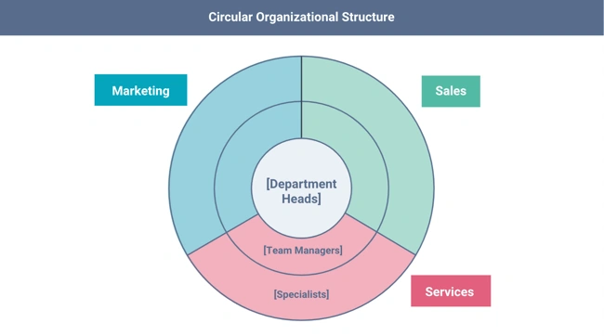
Circular Structure
While it might appear drastically different from the other organizational structures highlighted in this section, the circular structure still relies on hierarchy, with higher-level employees occupying the inner rings of the circle and lower-level employees occupying the outer rings.
That being said, the leaders or executives in a circular organization aren't seen as sitting atop the organization, sending directives down the chain of command. Instead, they're at the centre of the organization, spreading their vision outward
From an ideological perspective, a circular structure is meant to promote communication and the free flow of information between different parts of the organization. Whereas a traditional structure shows different departments or divisions as occupying individual, semi-autonomous branches, the circular structure depicts all divisions as being part of the same whole.

